Slide 1

Module 4
Advanced Multiple Linear Regression (MLR)
Notes:
Guidelines
Use section headers to chunk content in your presentation.
Use the same style of section header throughout your presentation.
Keep your title to no more than 2 lines.

Slide 2
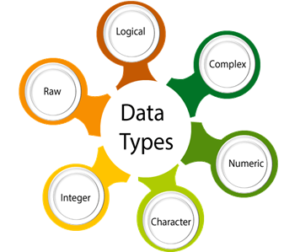
More on Variable Types
Notes:
Guidelines
Use a title slide at the beginning of your presentation. There are 9 variations of title slides to choose from.
If you will have a series of slideshows, we recommend using the same style of title slide for each presentation.
Keep your title to no more than 2 lines.
Do not change the font style or font size of the title or subtitle.

Slide 3
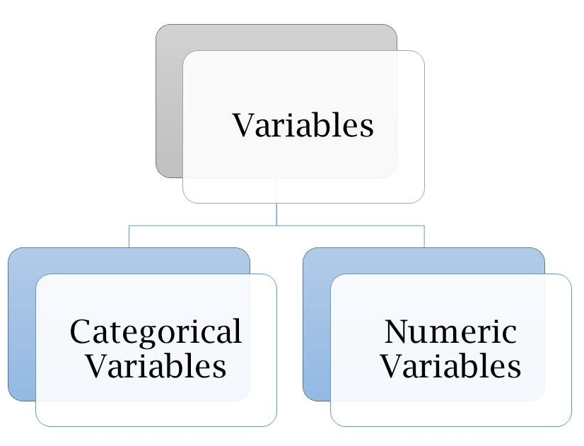
Variable Types
Quantitative (Numeric) Predictors: assume numerical values corresponding to points on a line.
Qualitative (Categorical or Factor) Predictors: have categories

Slide 4
Variable Types
We may need to correct types on real data

Slide 5

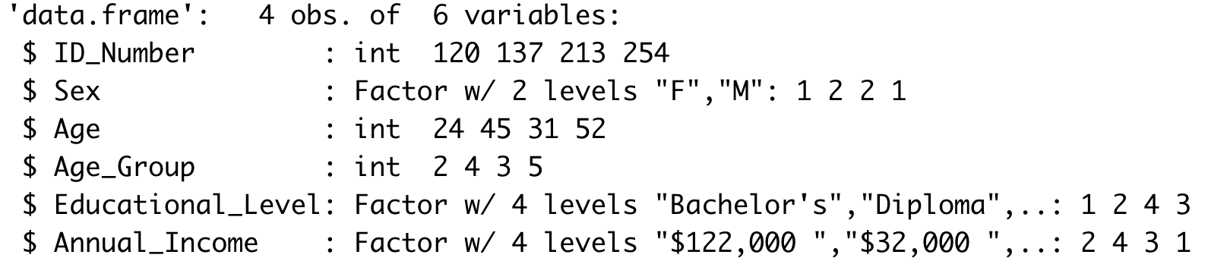
Variable Types

Slide 6
Correcting Variable Types
Changing categorical variables to numeric

Slide 7
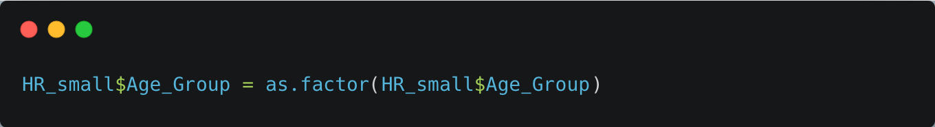
Correcting Variable Types

Slide 8
Correcting Variable Types
Changing numeric variables to categorical

Slide 9
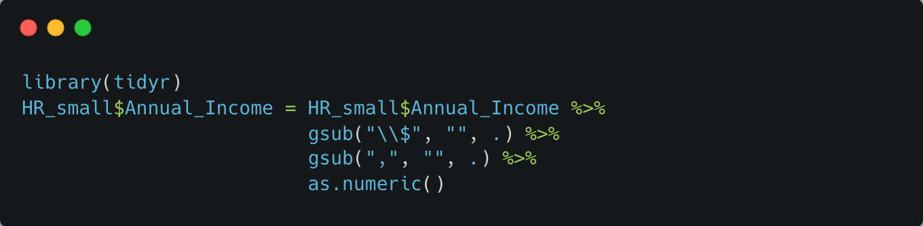
Correcting Variable Types

Slide 10
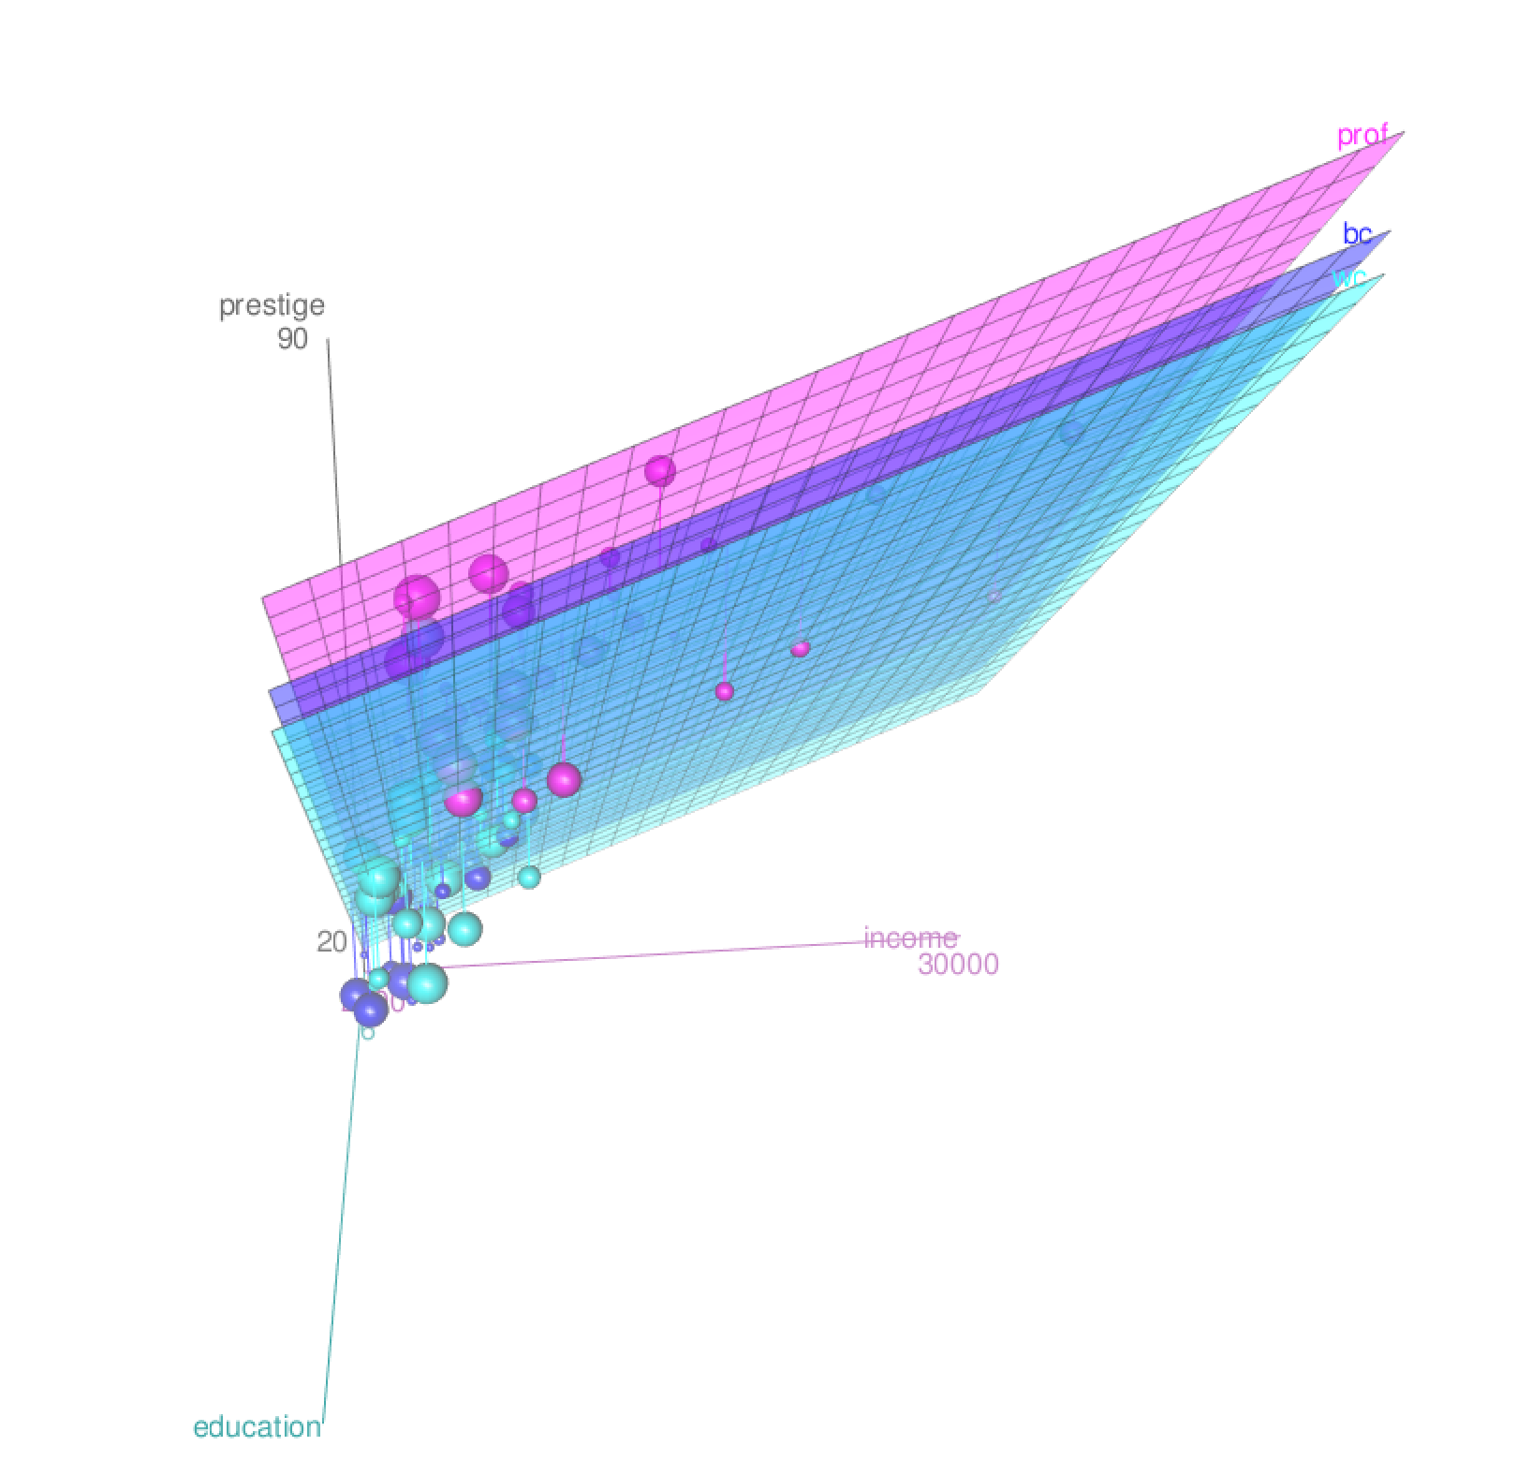
MLR with Categorical Predictors
Notes:
Guidelines
Use a title slide at the beginning of your presentation. There are 9 variations of title slides to choose from.
If you will have a series of slideshows, we recommend using the same style of title slide for each presentation.
Keep your title to no more than 2 lines.
Do not change the font style or font size of the title or subtitle.

Slide 11
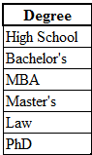
# of Levels in Categorical Variables
The Levels of a qualitative factor are defined only by the categories
6 levels

Slide 12

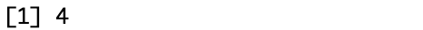
# of Levels in Categorical Variables

Slide 13

Levels in Categorical Variables

Slide 14
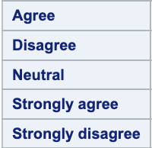
Reference Level Categorical Variables
Used in dummy-encoding.
Reference or base level is the level we compare against.
By default, most programming languages use alphabetical order
Default reference (base) level

Slide 15
Changing a Reference Level
We can change the reference level if needed
New reference (base) level

Slide 16
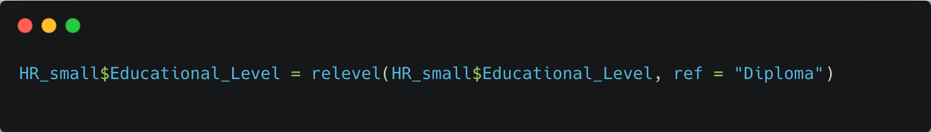
Changing a Reference Level
We can change the reference level if needed

Slide 17
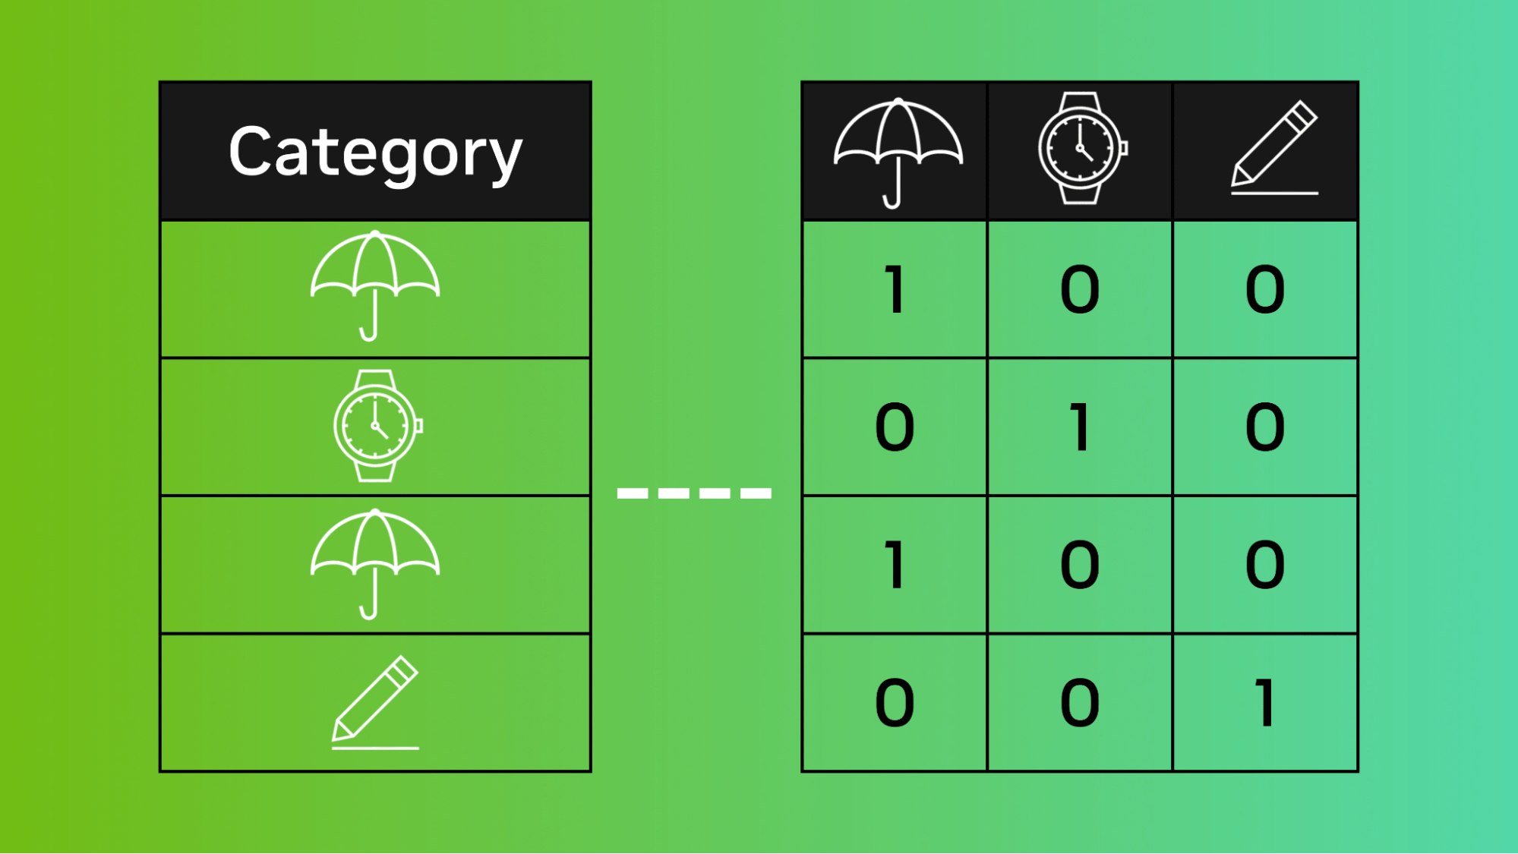
Encoding Categorical Variables
Notes:
Guidelines
Use a title slide at the beginning of your presentation. There are 9 variations of title slides to choose from.
If you will have a series of slideshows, we recommend using the same style of title slide for each presentation.
Keep your title to no more than 2 lines.
Do not change the font style or font size of the title or subtitle.

Slide 18
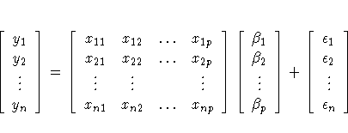
Categorical Variable Encoding
Every categorical variable has to be encoded numerically
Model matrix needs to be completely numeric

Slide 19
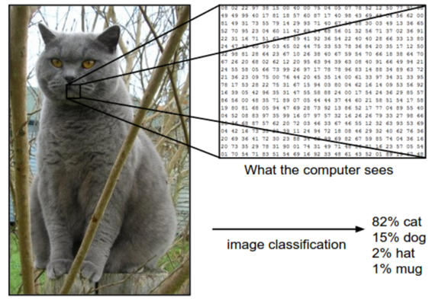
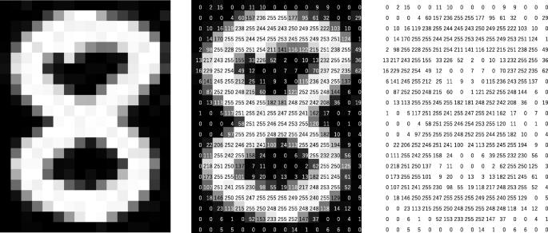
We can encode most types of data

Slide 20

We can encode most types of data

Slide 21
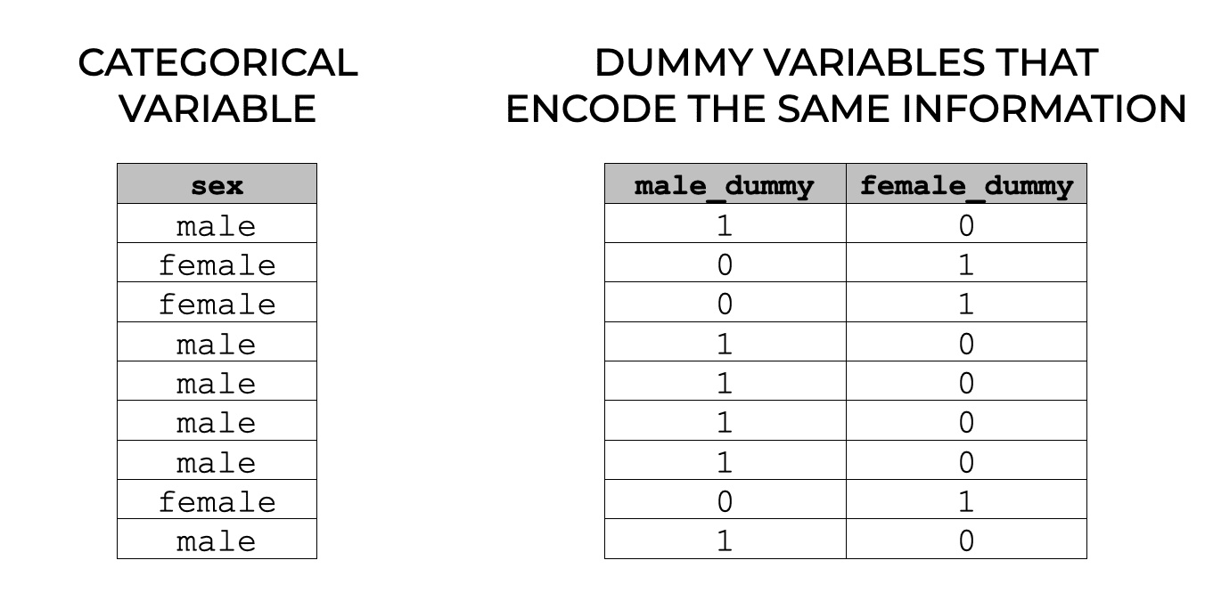
One-Hot Encoding
One-hot encoding creates 1 dummy variable per level

Slide 22
Dummy-Encoding
Dummy encoding creates (# levels – 1) dummy variables
The reference level is left out

Slide 23
Dummy-Encoding
Dummy encoding creates (# levels – 1) dummy variables
The reference level is left out

Slide 24
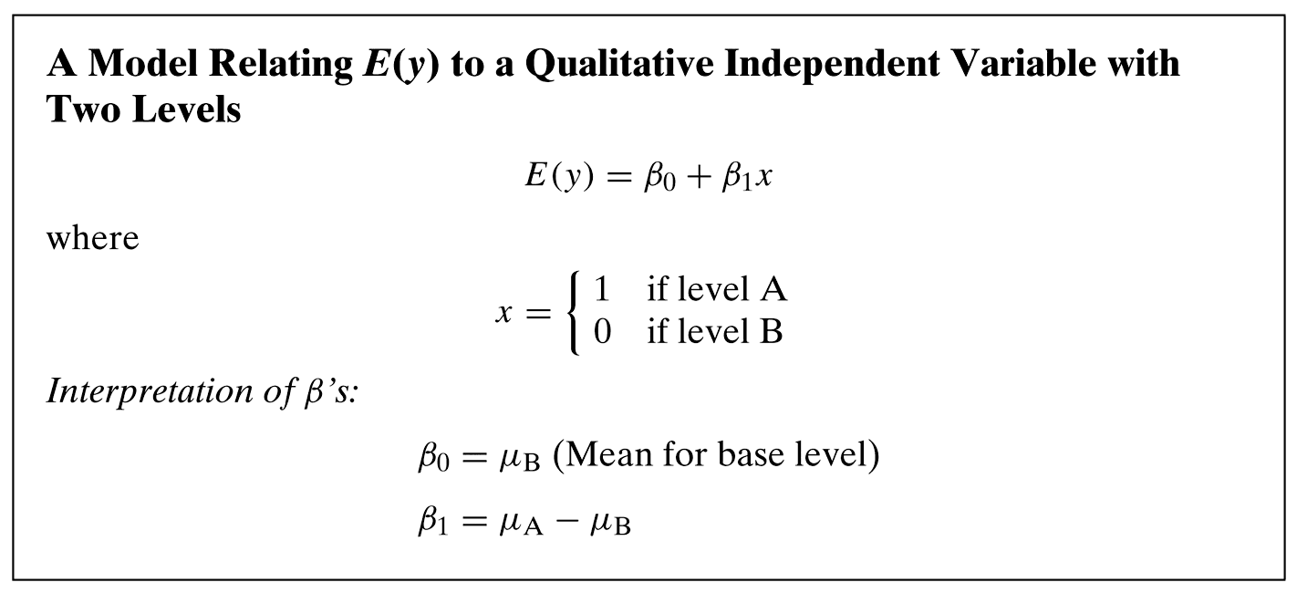
Dummy-Encoding

Slide 25
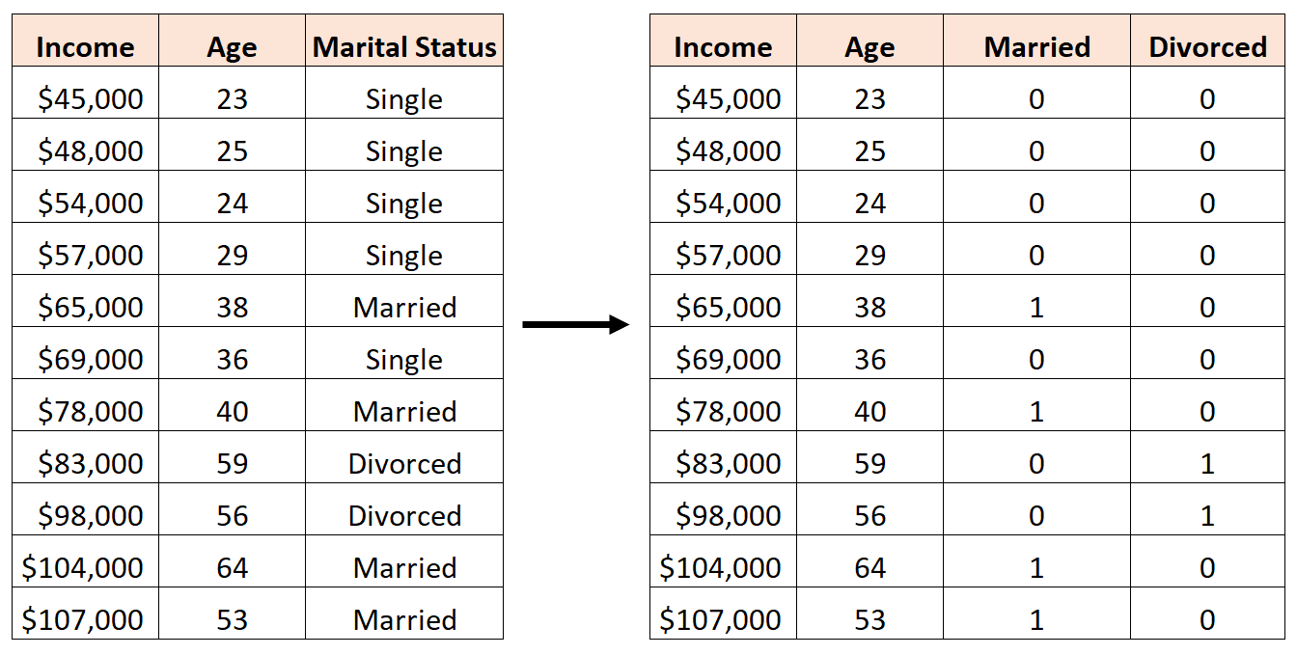
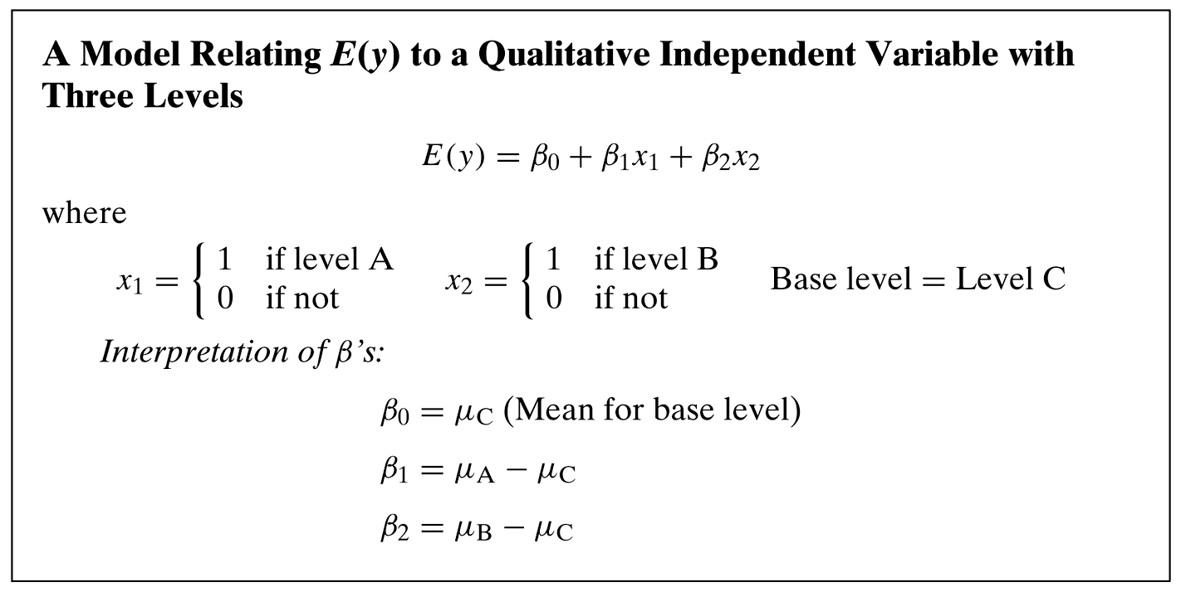
Dummy-Encoding

Slide 26
Dummy-Encoding

Slide 27

Practice

